Slide 1

OBJECT ORIENTED MODELLING & DESIGN (OOMD)
SOFTWARE TESTING
UE18CS400SB
Prof. Venkatesh Prasad
venkateshprasad@pes.edu
Department of Computer Science

Slide 2
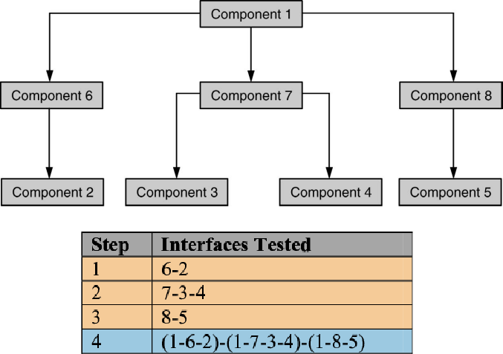
BI-DIRECTIONAL INTEGRATION

Slide 3
BI-Directional INTEGRATION
Combination of Top-down & Bottom up.
Individual components are separately tested.
Bi-Direction integration is done with use of Drivers & Stubs.
Drive - Upstream connectivity.
Stubs - Downstream connectivity.
Drivers & stubs are discarded after integration testing.
Sandwich Integration - is the combination of bottom-up approach and top-down approach, so it uses the advantage of both bottom up approach and top down approach. Initially it uses the stubs and drivers where stubs simulate the behaviour ogf missing component.

Slide 4
SYSTEM INTEGRATION
System integration means that all the components of the system are integrated together and tested as an entire unit.
2 types :
Sub System Integration
Final/ system integration
Big Bang Integration – approach in which all software components (modules) are combined at once and make a complicated system. This unity of different modules is then tested as an entity.
Ideal for a product where the interfaces are stable and less number of defects.

Slide 5
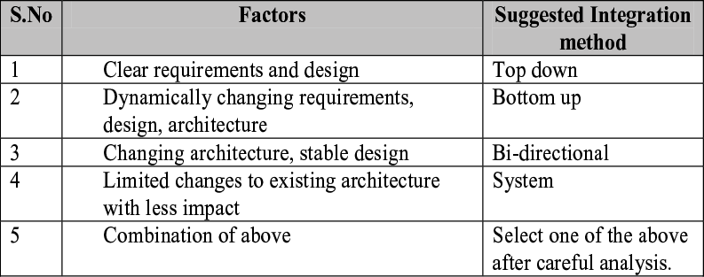
SELECTING INTEGRATION METHOD

Slide 6
SYSTEM TESTING(END TO END TESTING)
Testing “full aspect of main functionality” – A business process for example.
Create scenarios
Story-line : Develop a story-line that combines various activities of the product
Life-cycle / state transitions: Consider an object, derive the different transitions / modification that happen to the object and derive scenarios to cover them
Deployment / implementation details from customer
Business verticals: Visualizing how a product / software will be applied to different business verticals and create a set of activities as scenarios (e.g., insurance, life sciences)
Battle-ground scenarios: Create some scenarios to justify “the product works” and some scenarios to “try and break the system” to justify “the product doesn’t work.”

Slide 7
SCENARIO TESTING(END TO END TESTING)
Testing “full aspect of main functionality” – A business process for example.
Ex. Order processing:
Create customer, create product, collect customer order, prepare making/packing, dispatch, collect money
Focus is on ensuring the full function works and the associated building blocks are integrated well.
This the first step to do full functional test with detailed sub-steps.

Slide 8
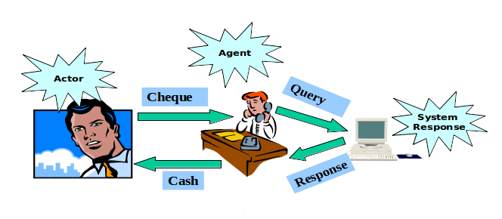
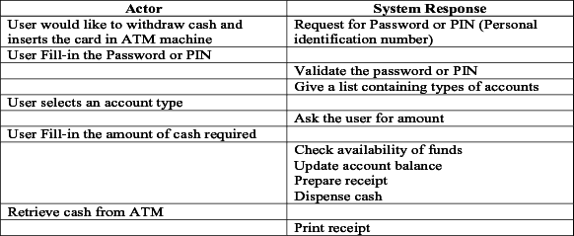
USE-CASE SCENARIO - INTEGRATION TESTING

Slide 9
STEPS IN INTEGRATION TESTING
Step 1: Create Test Cases and Test Data
Step 2: Create a Test Plan
Step 3: Once the planned components have been integrated, setup along with environment
Step 4: Execute the test cases
Step 5: Report results
Step 6: Repeat steps 4 & 5 when required – if defects
Step 7: Repeat the above test until all the components have been successfully integrated
Other: Use automation – tools/scripts – where appropriate

Slide 10
STEPS IN INTEGRATION TESTING
Step 1: Create Test Cases and Test Data
Step 2: Create a Test Plan
Step 3: Once the planned components have been integrated, setup along with environment
Step 4: Execute the test cases
Step 5: Report results
Step 6: Repeat steps 4 & 5 when required – if defects
Step 7: Repeat the above test until all the components have been successfully integrated
Other: Use automation – tools/scripts – where appropriate

Slide 11
OBJECT ORIENTED MODELLING & DESIGN (OOMD)
THANK YOU
Prof. Venkatesh Prasad
venkateshprasad@pes.edu
Department of Computer Science

